Slide 1
Video Games Data Analysis
Yasin Aydın – Batuhan Kaya

Slide 2
This dataset collects video game sales data up to 2016.
1-Game Identifiers: 2-Sales Data (in Millions): 3-Rating System: Business Purpose of the Dataset: -Marketing analysis: -Platform strategies: -Trend analysis: -Success factors:

Slide 3

1. Data Reading and Sampling
Dataset InformationSource: Kaggle - "Video Game Sales as at 22 Dec 2016«
Original size: 16,719 rows × 16 columns
Sample size: 2000 rows (random_state=5009)
Advantages:
More manageable data size
Faster analysis and visualization
Resource conservation

Slide 4
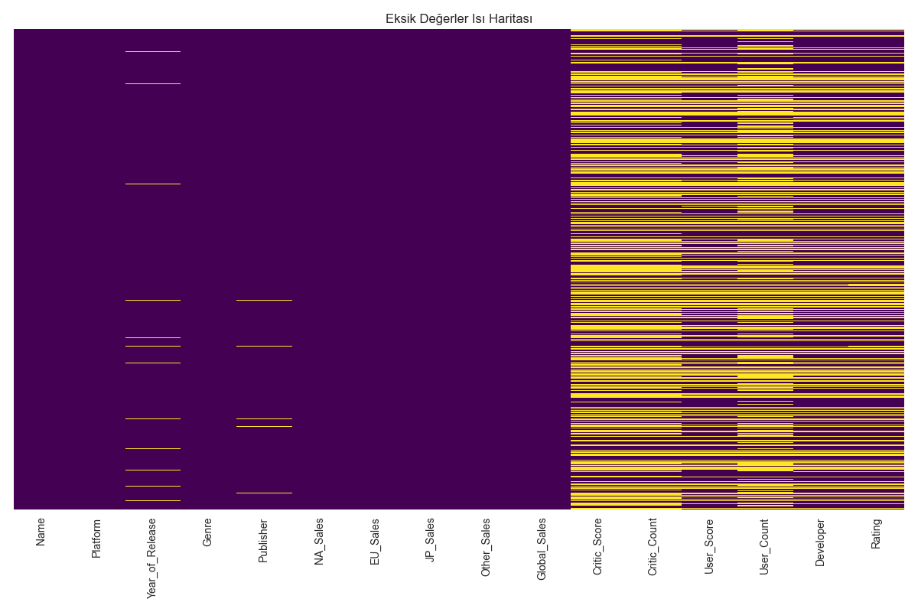
2. Missing Value Analysis and Cleaning
Feature | Missing %
User_Count | 54%
Critic_Score | 50%
Critic_Count | 50%
Rating | 39%
User_Score | 38%
Developer | 38%
(Missing Values Heatmap)

Slide 5
Missing Value Treatment Strategies:
1-Year_of_Release: Imputed with median
2-Categorical Variables: Imputed with mode
3-User_Score: Converted to numeric

Slide 6
3. Exploratory Data Analysis (EDA)
Categorical Variables Analysis
Platform distribution: Identified platforms with most games
Genre analysis: Game counts and sales performance by genre
Relationship with global sales: Impact of categorical variables on sales
Numerical Variables Analysis
Sales distributions: Histograms of NA_Sales, EU_Sales, JP_Sales
0-1 million concentration: Most games sell within this range
Outlier presence: Some high-selling games detected
Global sales boxplot: Visualization of distribution and outliers

Slide 7
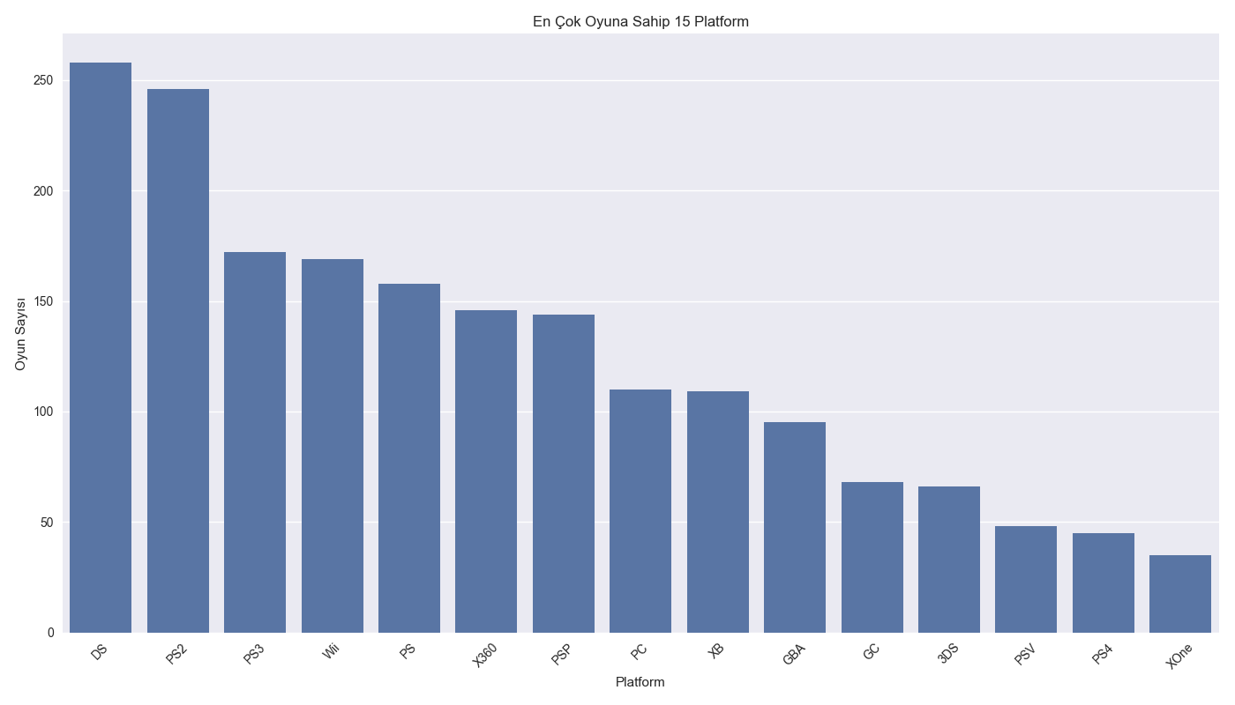
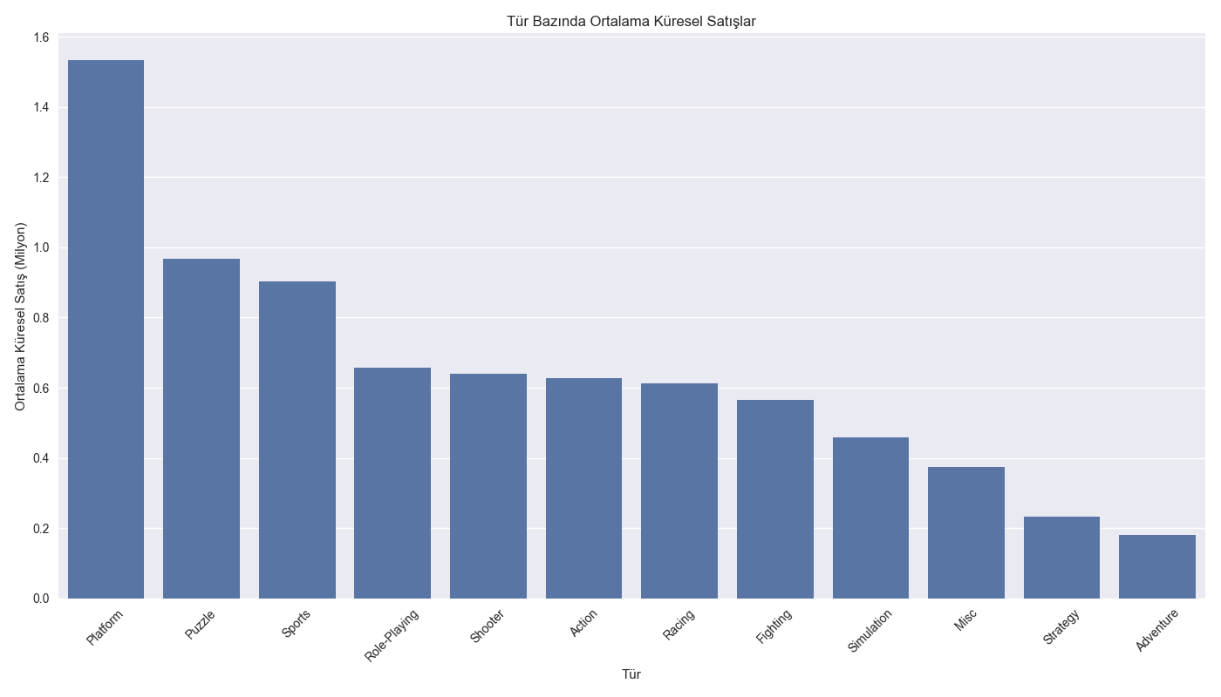
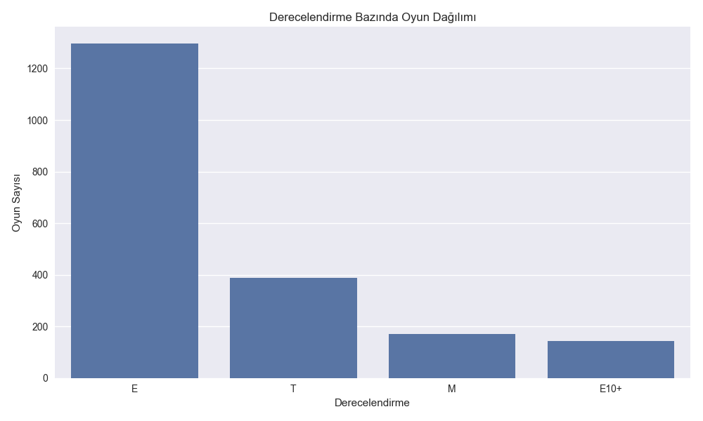
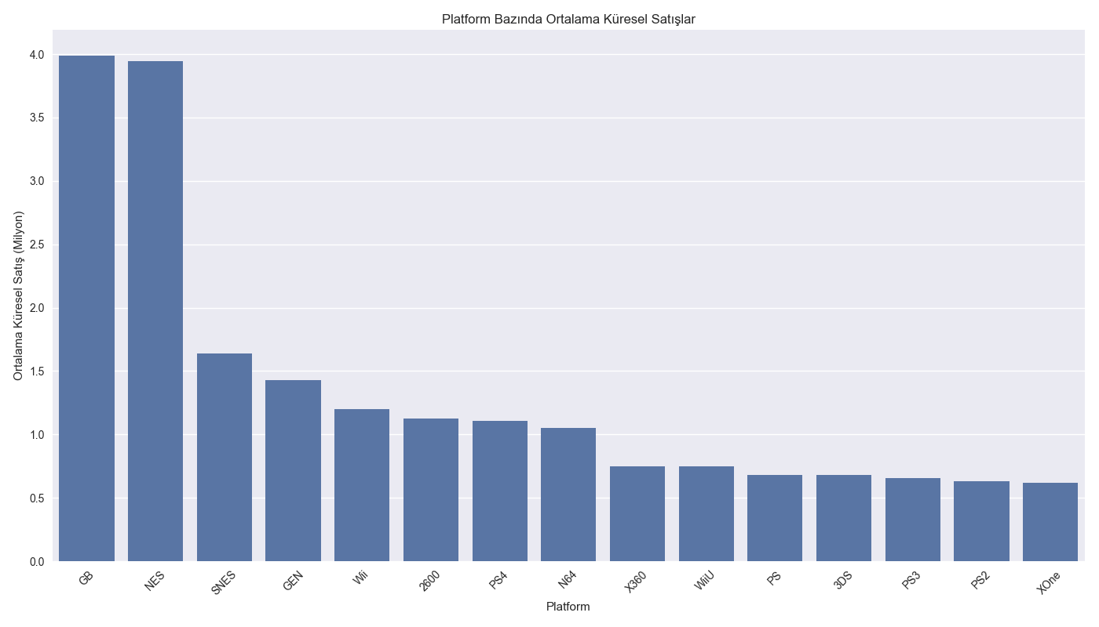
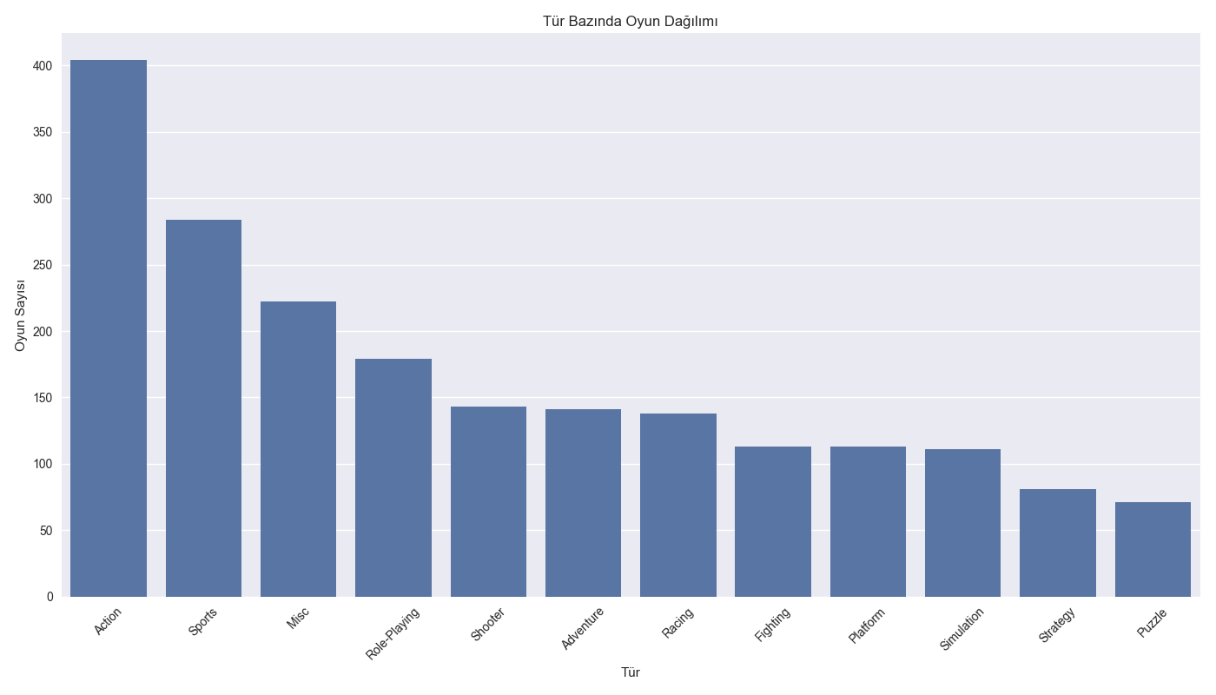
Categorical Variables Analysis
(Platform Distribution)
(Genre avg. sales)
(Rating Distribution)
(Platform Avg Sales)
(Genre Distribution)

Slide 8
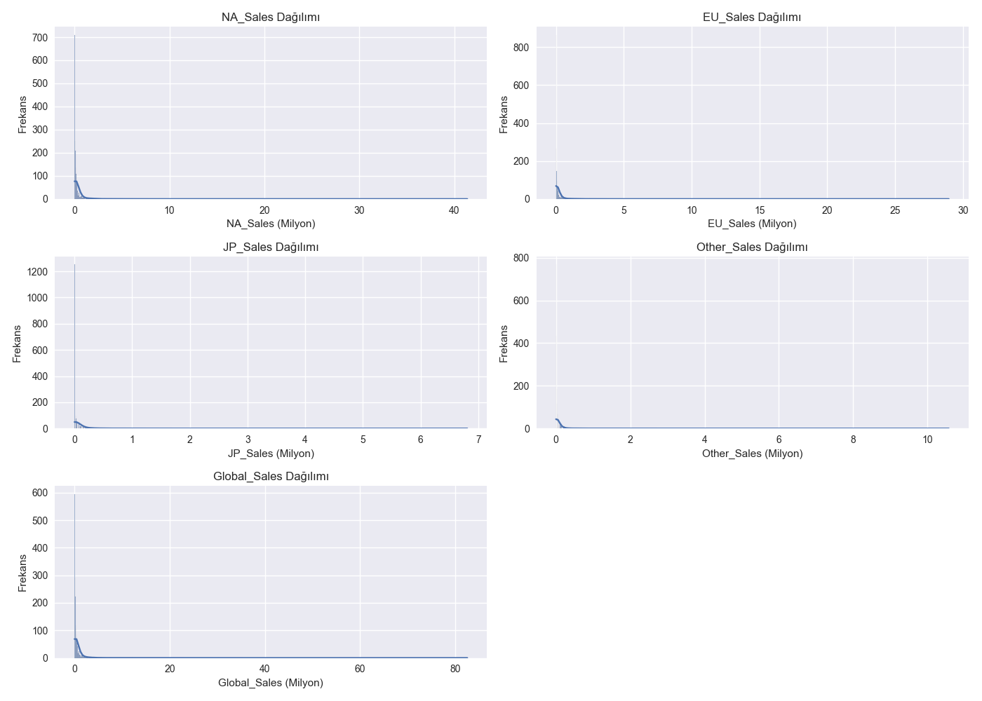
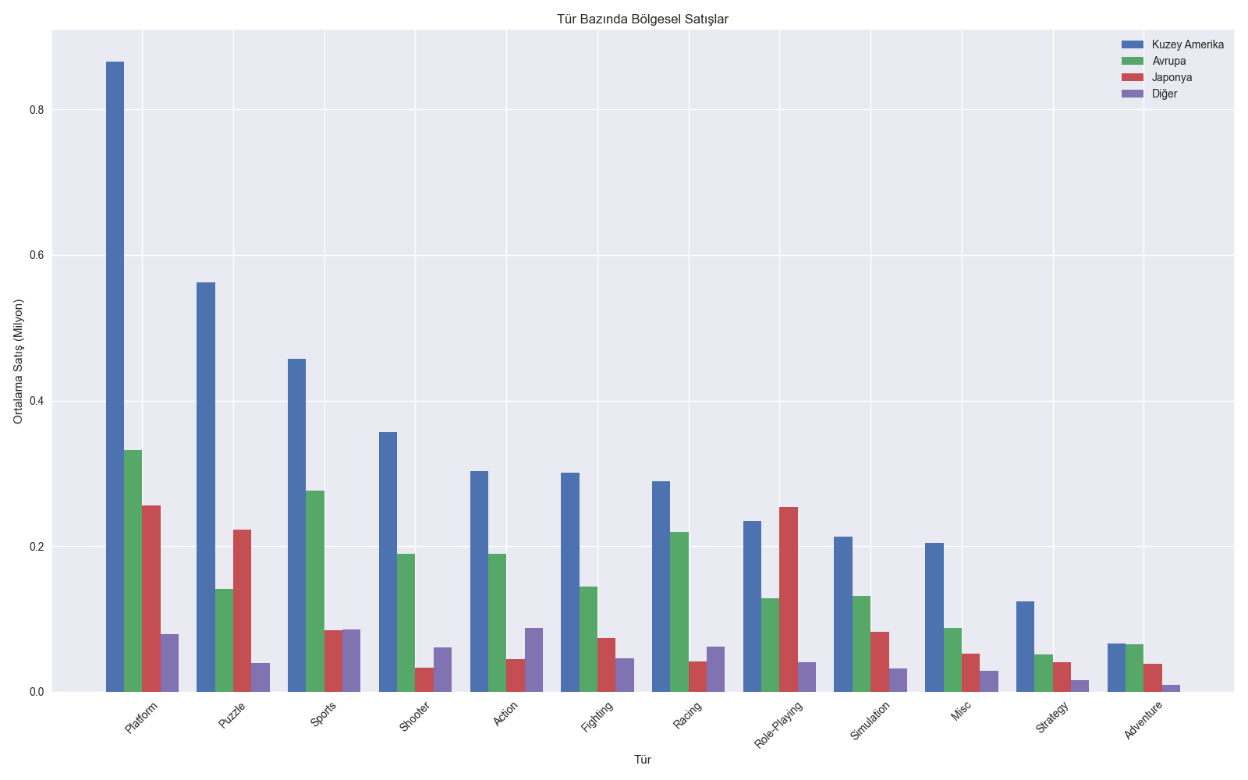
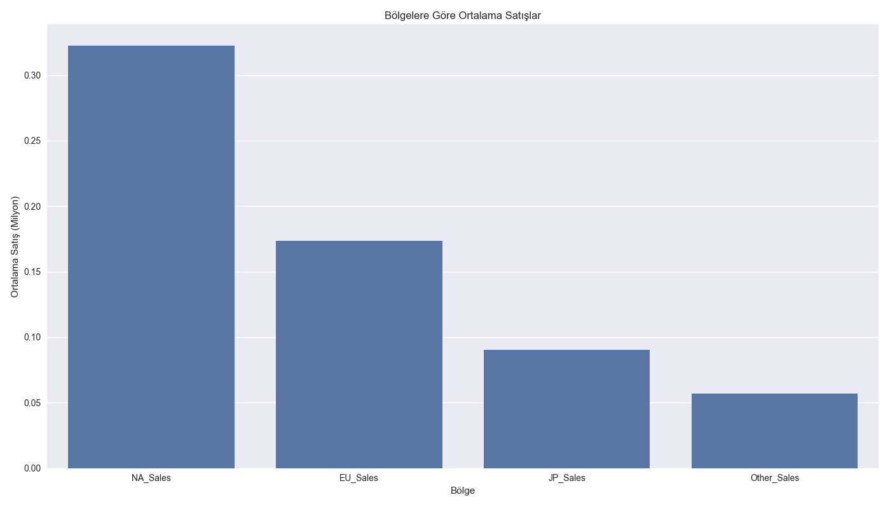
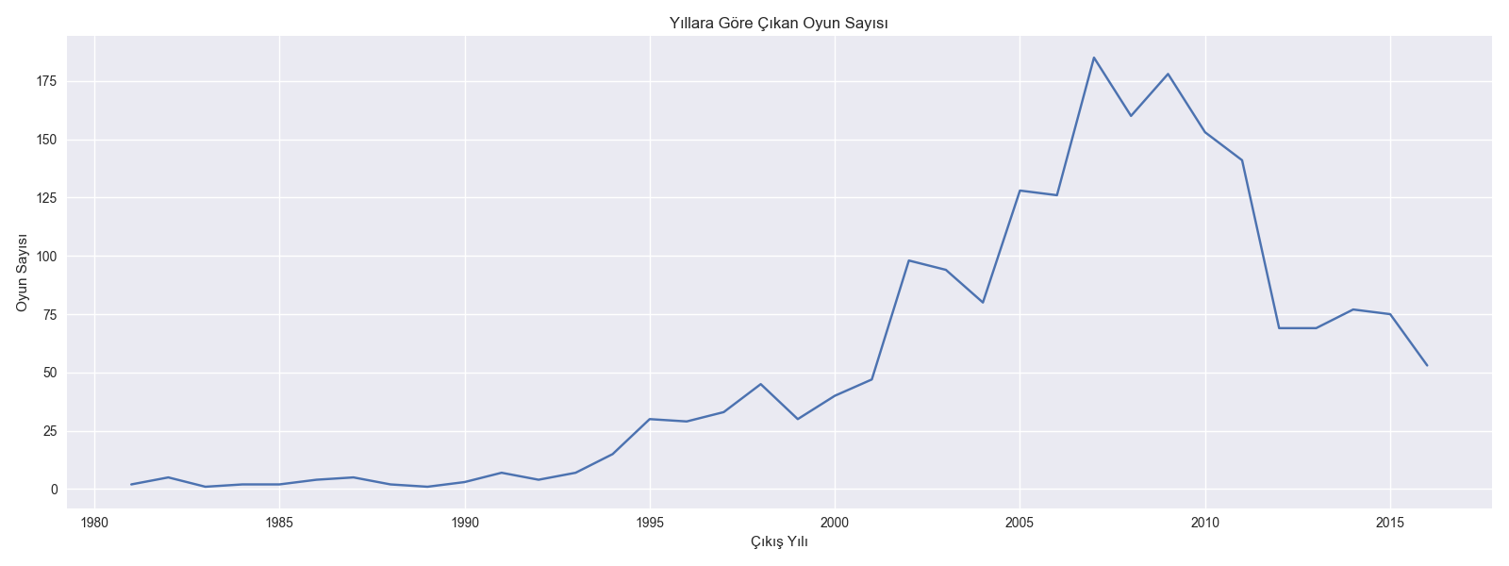
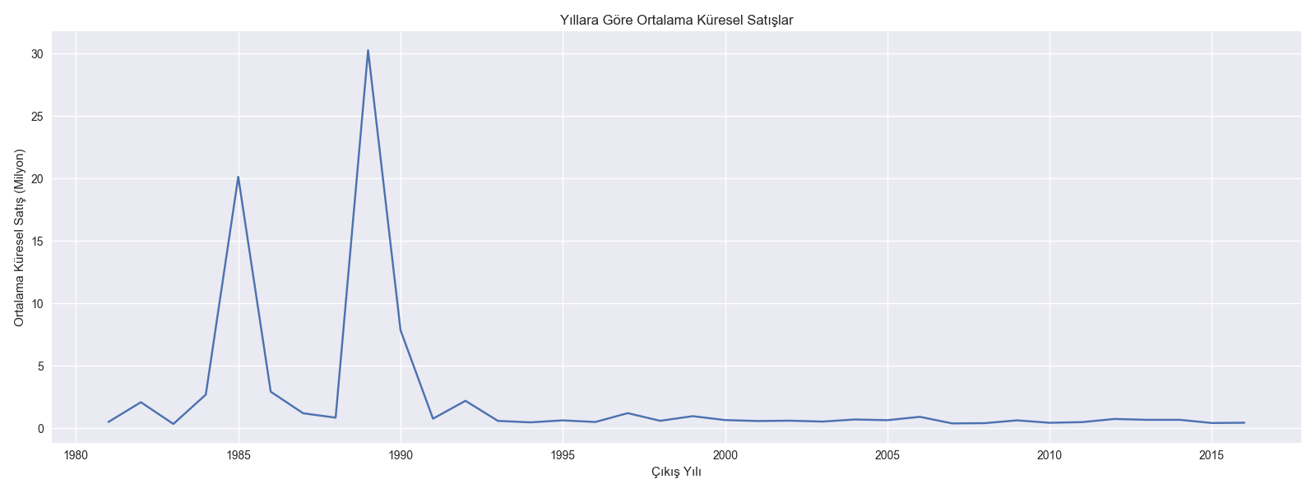
Numerical Variables Analysis

Slide 9
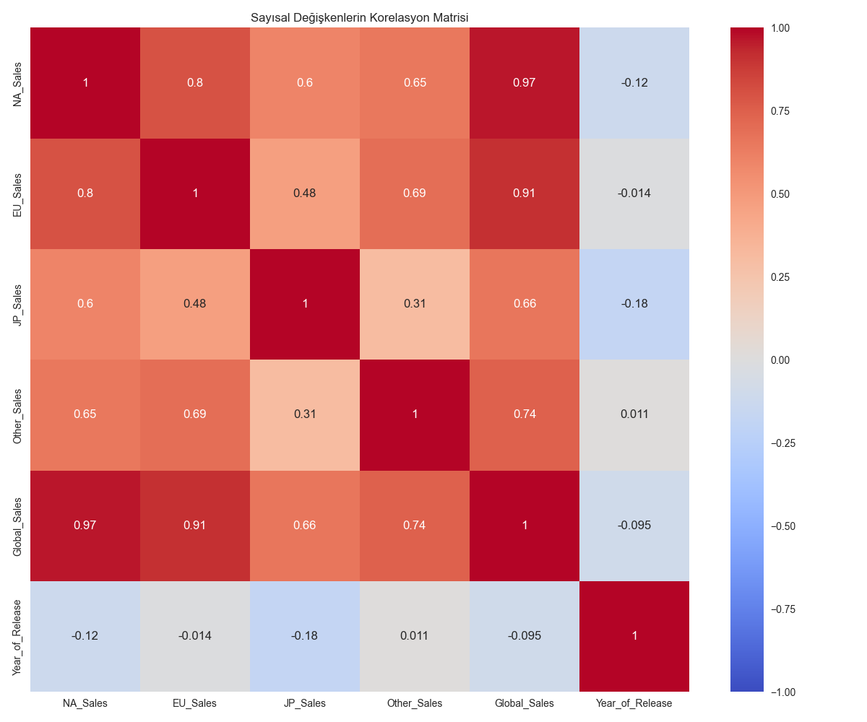
4. Correlation Analysis
Strong Relationships
NA_Sales vs Global_Sales: 0.96
EU_Sales vs Global_Sales: 0.90
Findings
Global sales are heavily influenced by North American and European sales
Strong positive correlation between regional sales

Slide 10
5. Standardization and Clustering
Rationale for Standardization
Distance-based algorithms: Sensitivity to different scales
Feature dimensions: Sales (millions) vs. User_Score (0-10)
Need: Bringing all features to the same scale

Slide 11
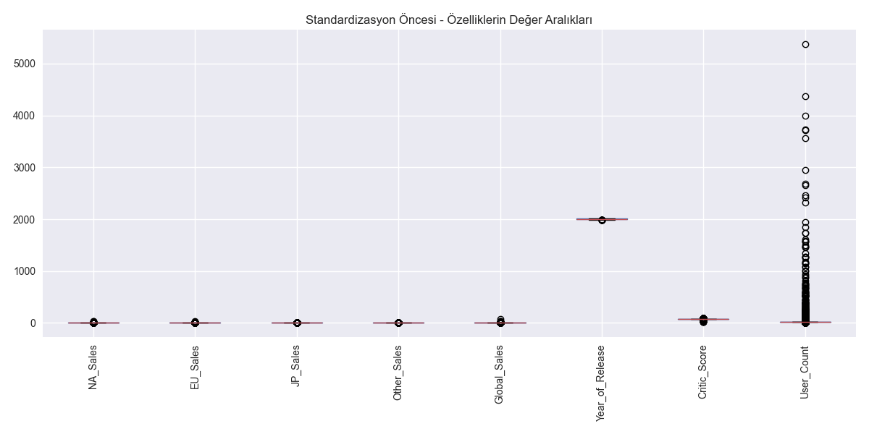
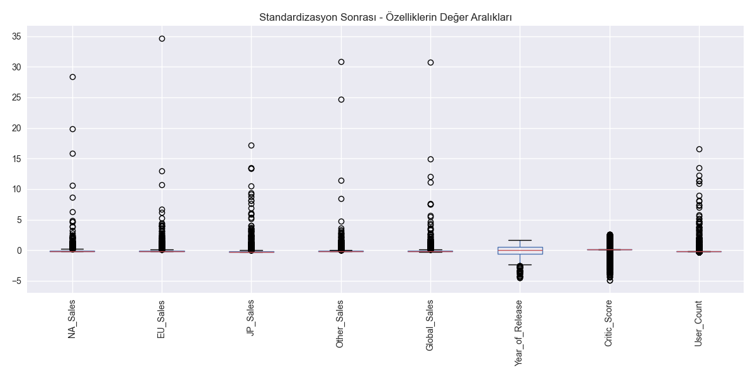
5. Standardization and Clustering
Features Used for Clustering
Sales columns (NA_Sales, EU_Sales, JP_Sales, Other_Sales, Global_Sales)
Release year (Year_of_Release)
Critic_Score
User_Count
(Before Standardization)
(After Standardization)

Slide 12
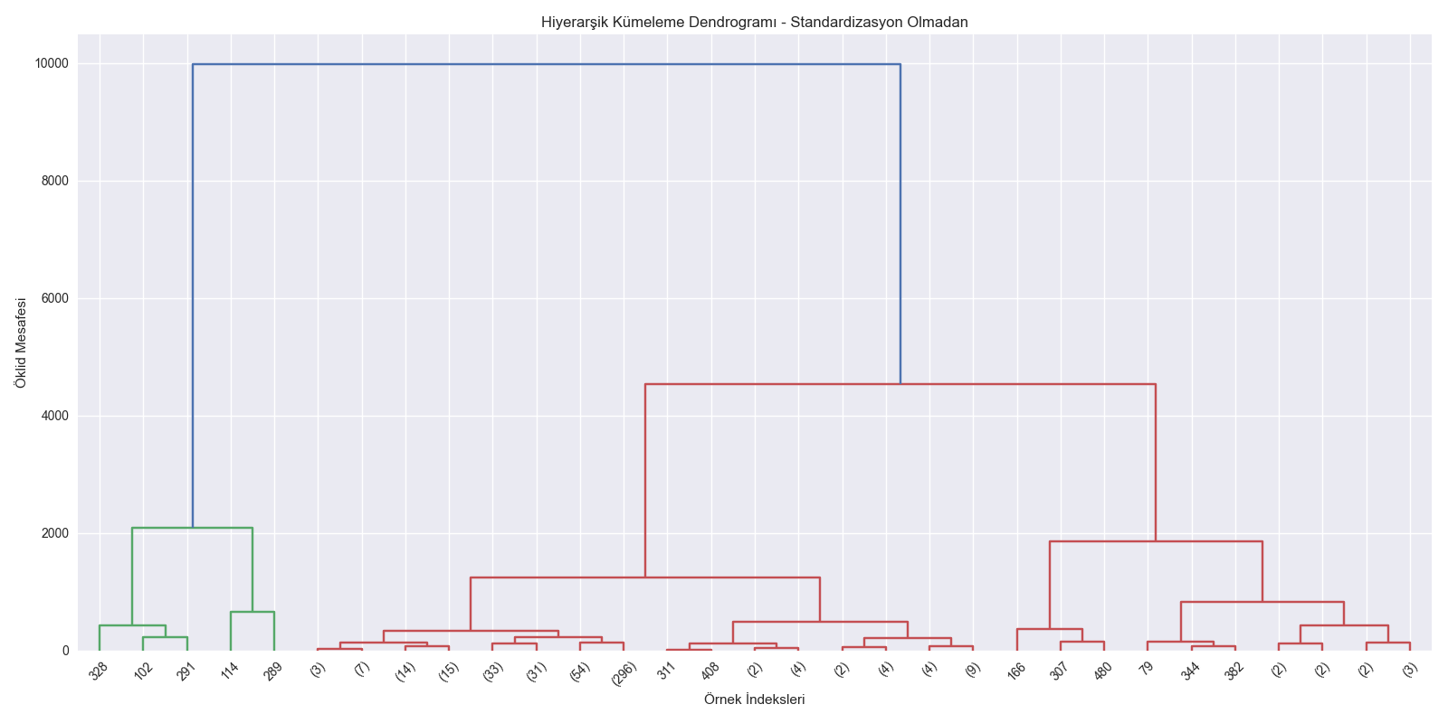
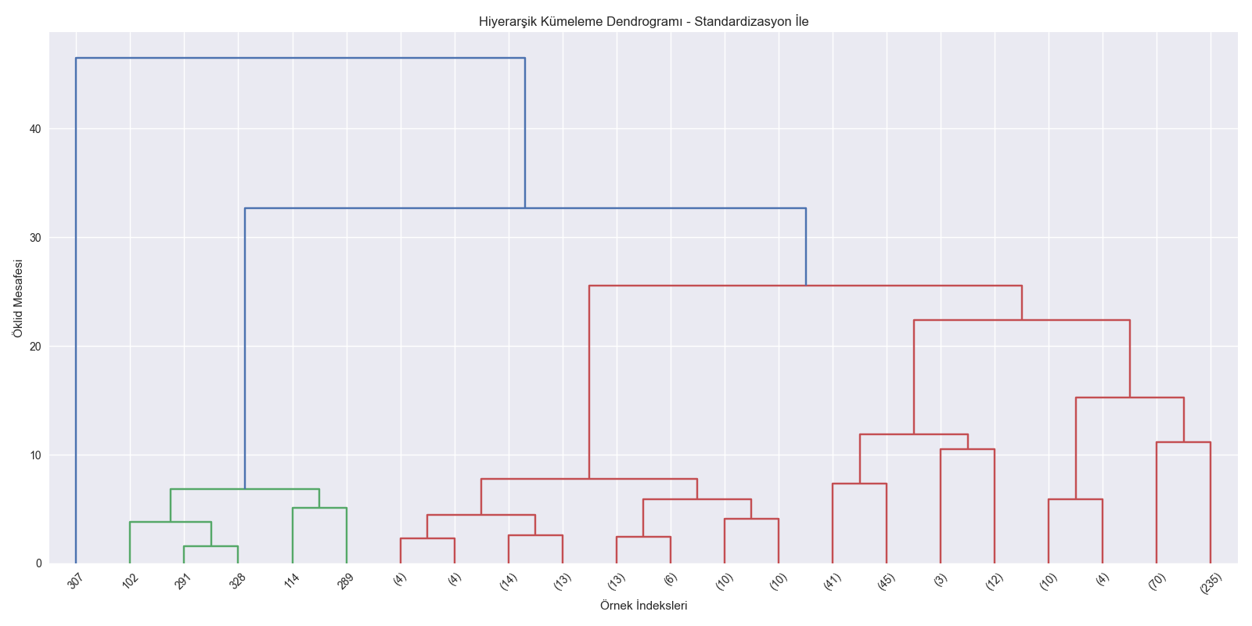
6. Dendrogram Comparison
Ward Linkage Usage

Slide 13
Two Different Approaches
Without Standardization
Large-value features dominate
Sales values determine clustering results
With Standardization
Large-value features dominate
Sales values determine clustering results

Slide 14
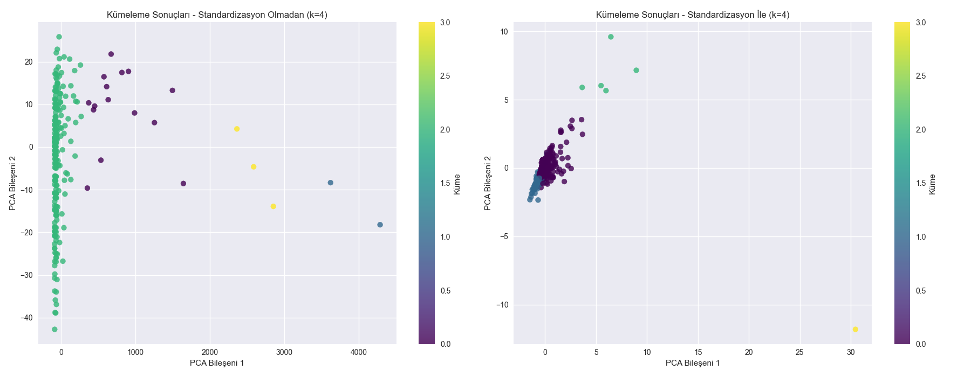
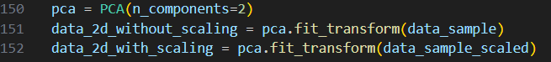
7. PCA and Clustering Comparison
2D Visualization
Results (n_clusters=4)
Without standardization: Irregular, unbalanced clusters
With standardization: More separated, balanced structures
(Clustering Comparison)
AgglomerativeClustering Results

Slide 15
8. Conclusions and Evaluation
Critical Effects of Standardization
1-Scale differences in features:
Sales values (millions)
User_Score (0-10 range)
Very different feature dimensions
2-Impact on clustering:
Significant changes in dendrogram structures
Different cluster memberships
More meaningful cluster distributions
3-Changes in distance measures:
Absolute values vs. standardized values
Equally weighted feature contributions

Slide 16
Recommendations
Standardization is mandatory for video game projects
Use StandardScaler for features with different scales
Data exploration and preprocessing are crucial before clustering

Slide 17
Regression Analysis
What is Regression?
A statistical method modeling the relationship between dependent and independent variables
Used to predict continuous values
Example: Predicting global sales of video games
Purpose of Regression
Prediction: Estimating unknown values and forecasting future outcomes
Relationship Analysis: Understanding the effect and connection between variables
Models Used
Linear Regression: Simple, interpretable, for linear relationships
K-Nearest Neighbors (KNN): Captures nonlinear relationships, higher computational cost
Decision Tree: Models complex relationships, prone to overfitting
Random Forest: Combines multiple trees for reliable predictions, harder to interpret

Slide 18
Regression Analysis
Evaluation Metrics
MSE: Mean squared error, lower is better
RMSE: Square root of MSE, in original units
R² Score: Explained variance, closer to 1 is better
Importance of Regression
Valuable for sales forecasting and market analysis
Predicting sales potential of new games and developing strategies
Decision support for developers, publishers, and investors

Slide 19
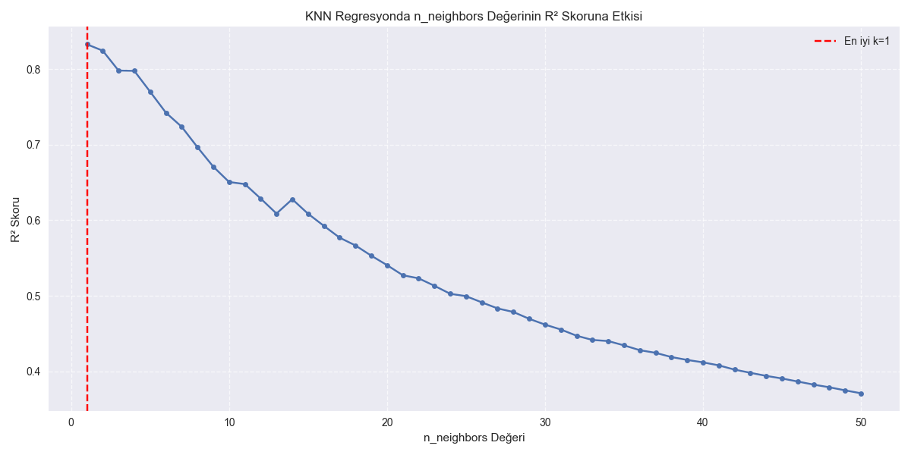
Applied Regression Models
Models Used to Predict Global Sales
Model | RMSE | R² Score
Linear Regression | 0.0008 | 1.0000
KNN Regression (n=5) | 0.8344 | 0.7703
Decision Tree Regression | 0.5708 | 0.8914
Random Forest Regression | 0.5249 | 0.9088
Parameter k was scanned in the 1-50 range:
Best n_neighbors value = 2
Optimized KNN R² score = 0.8337

Slide 20
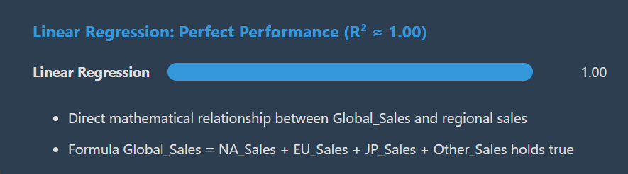
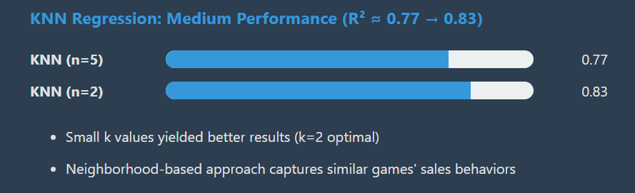
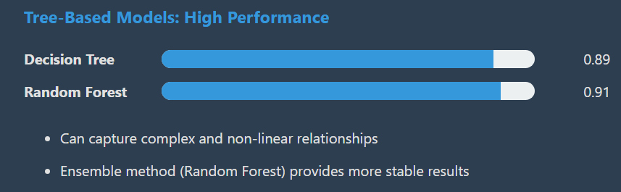
Regression Results and Interpretations

Slide 21
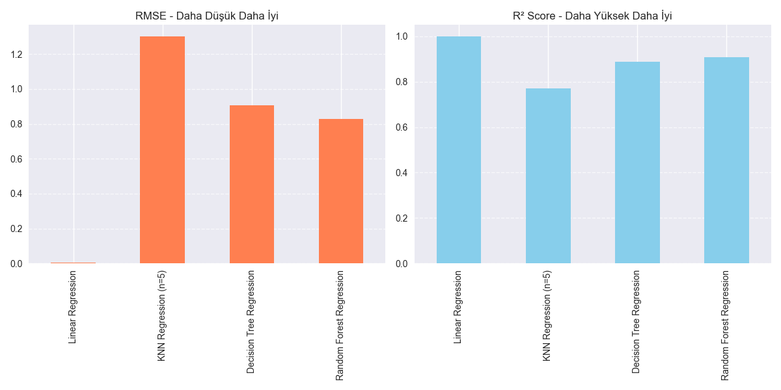
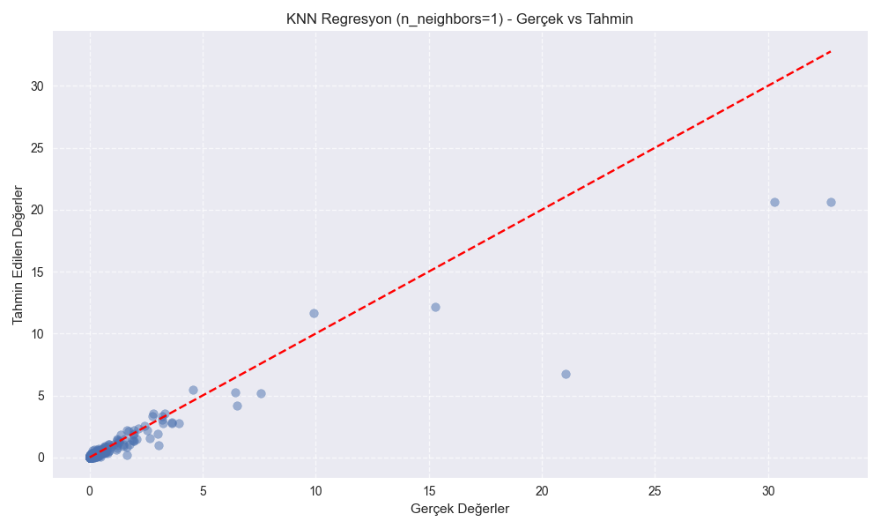
Regression Visualizations
RMSE: Lower is better (Linear Regression superior)
R² Score: Higher is better (Linear Regression superior)
KNN model (n=2) predictions are close to actual values
Deviation increases for higher sales values
KNN Optimization

Slide 22
KNN Optimization
R² performance decreases as n_neighbors value increases
Lower k values perform better - close neighborhood is important in game sales

Slide 23
Classification Analysis
What is Classification?
A machine learning method that assigns data to predefined categories
Used to predict discrete values
Example: Classifying video games as successful or unsuccessful
Purpose of Classification
Categorization: Group data meaningfully and assign new examples correctly
Pattern Recognition: Identify patterns and differences between classes
Models Used
Logistic Regression: Simple, interpretable, for binary classification
K-Nearest Neighbors (KNN): Captures nonlinear boundaries, computationally intensive
Decision Tree: Models complex decision rules, prone to overfitting
Random Forest: Combines multiple trees for reliable classification, less interpretable

Slide 24
Classification Analysis
Evaluation Metrics
Accuracy: Overall correct predictions rate
Precision: Correct positive predictions over total predicted positives
Recall: Correct positive predictions over total actual positives
Confusion Matrix: Detailed counts of true/false positives and negatives
Class Imbalance & Importance
Occurs when class sizes differ greatly (e.g., fewer successful games)
Affects model performance
Addressed by downsampling, upsampling, or synthetic data methods like SMOTE
Importance in Our Work
Predicting game success potential
Risk assessment and resource planning
Supporting developers, publishers, and investors
Cross-Validation
Provides reliable model evaluation
Detects overfitting and tests generalization
10-fold cross-validation splits data into 10 parts and averages results

Slide 25
Classification Models and Results
Model | Accuracy | Precision | Recall
Logistic Regression | 0.9270 | 0.9310 | 0.9231
KNN Classifier | 0.8793 | 0.8598 | 0.9077
Decision Tree | 0.9820 | 0.9830 | 0.9808
Random Forest | 0.9798 | 0.9951 | 0.9649
Decision Tree and Random Forest: Highest accuracy (98%+)
Random Forest: Highest precision (99.5%) - Minimizes false positives
Logistic Regression: Strong baseline performance (92.7%)
Even a simple KNN classifier achieves 88% accuracy
**
Class 0: 1014 sample (50.7%)
Class 1: 986 sample (49.3%)
Imbalance Rate : 1.03

Slide 26
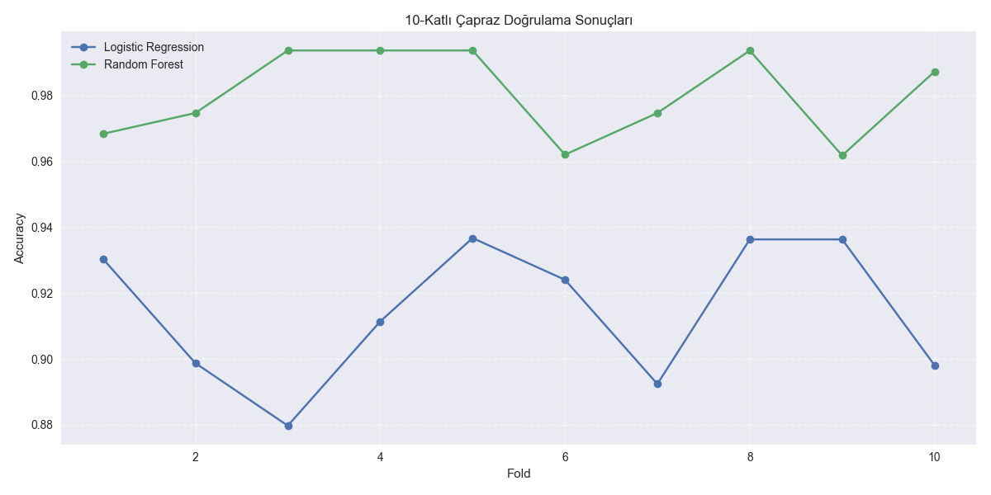
Cross-Validation & Insights
Logistic Regression
Mean accuracy: 0.9257
Standard deviation: 0.0177
Test set accuracy: 0.9270
Random Forest
Mean accuracy: 0.9789
Standard deviation: 0.0103
Test set accuracy: 0.9798

Slide 27
Cross-Validation & Insights
Overfitting Check
Overfitting is typically observed when there is a significant difference (5% or more) between training accuracy and test accuracy. Since this difference is very small in our models, we can conclude that our models do not suffer from overfitting.
Applications and Insights
Game publishers can predict game success in advance
Invest in marketing strategies for games with high success probability
Identify commercial success factors in the game development process
Use prediction models for regional sales strategies

Slide 28
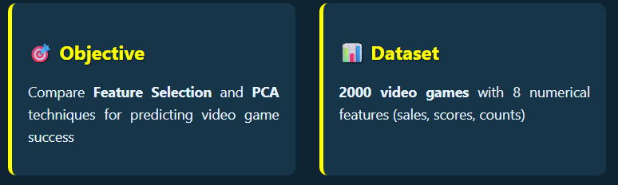
Comparative Analysis
Why This Matters?
Curse of Dimensionality: Too many features can hurt model performance
Feature Selection: Choose best original features (interpretable)
PCA: Transform features into new components (dimensionality reduction)

Slide 29
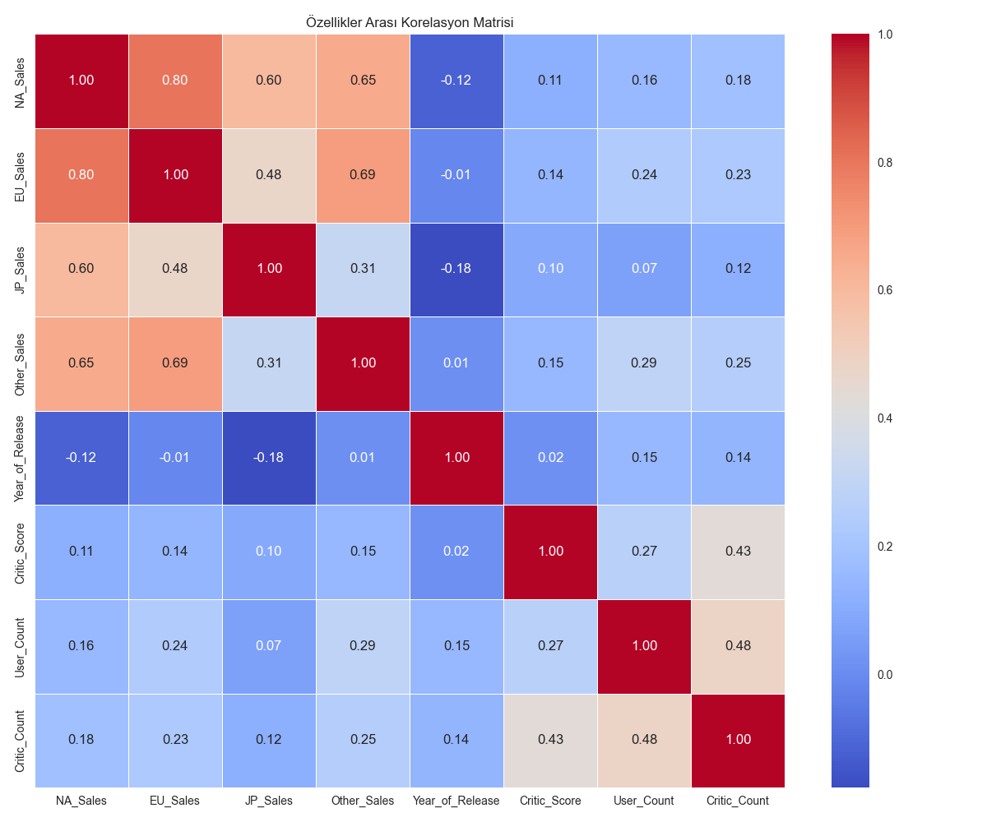
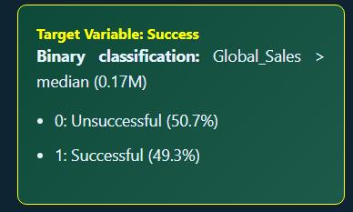
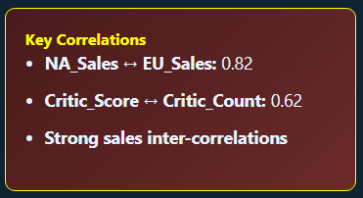
Dataset and Target Variable
📈 Features Used
Sales: NA_Sales, EU_Sales, JP_Sales, Other_Sales
Reviews: Critic_Score, Critic_Count, User_Count
Time: Year_of_Release

Slide 30
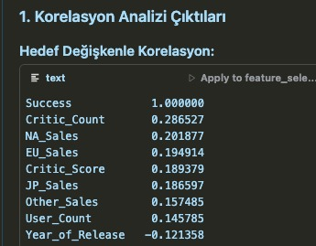
Dataset and Target Variable

Slide 31
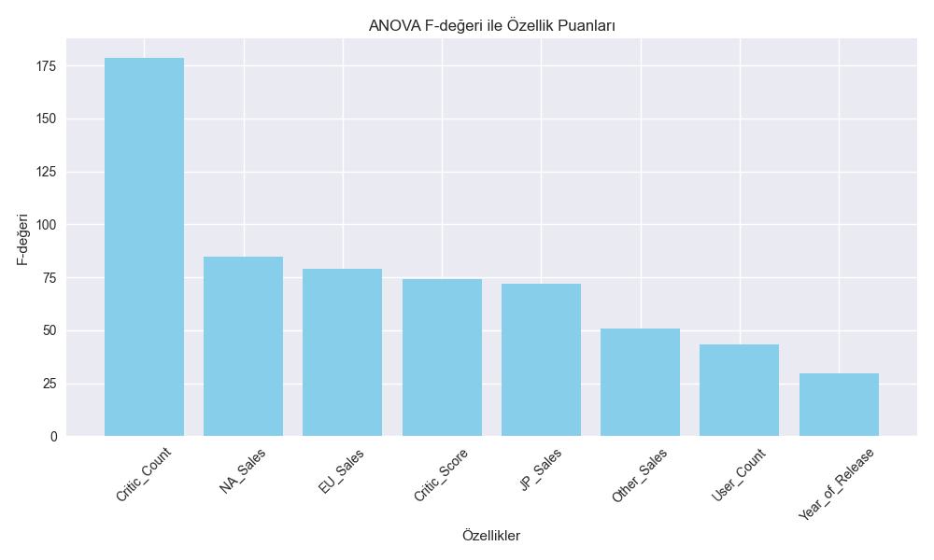
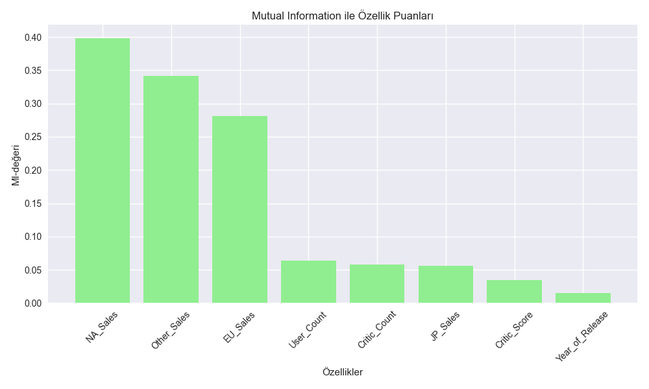
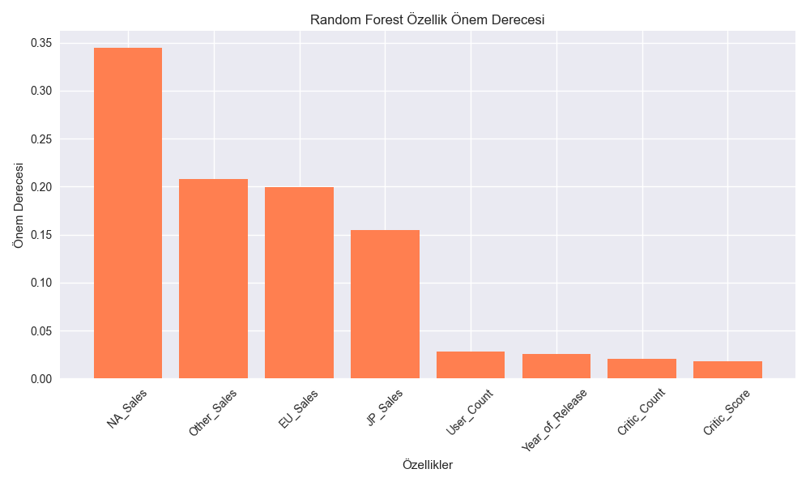
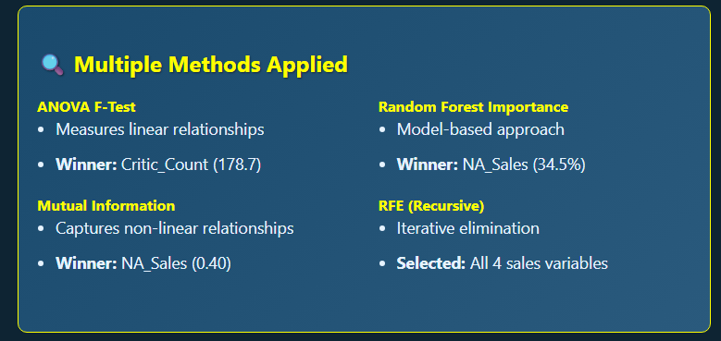
Feature Selection Methods

Slide 32
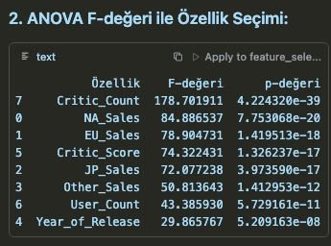
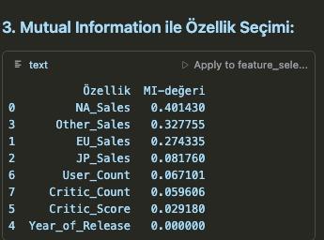
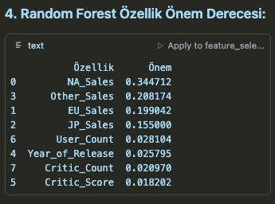
Feature Selection Methods

Slide 33
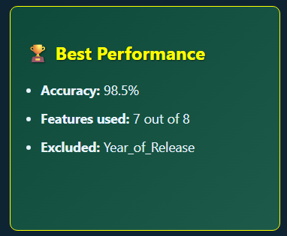
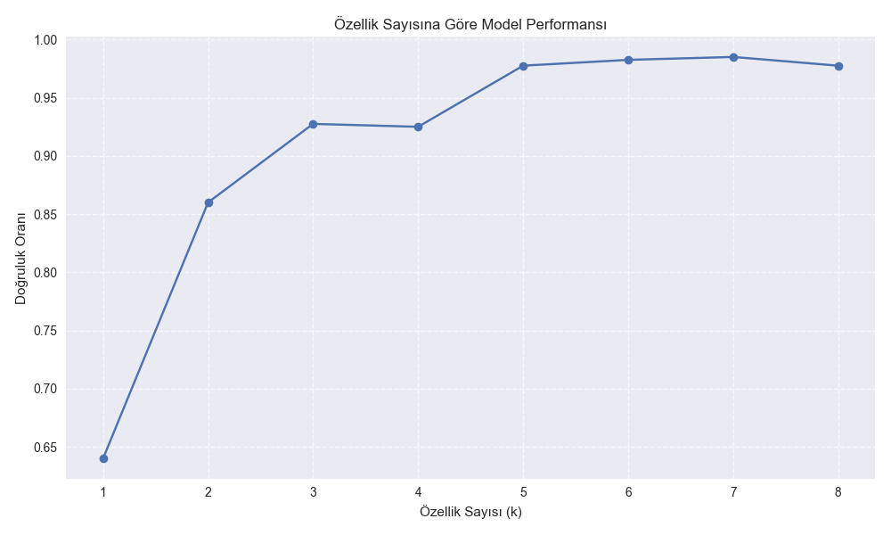
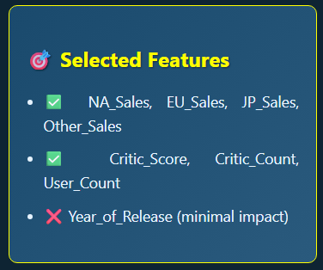
Optimal Number of Features

Slide 34
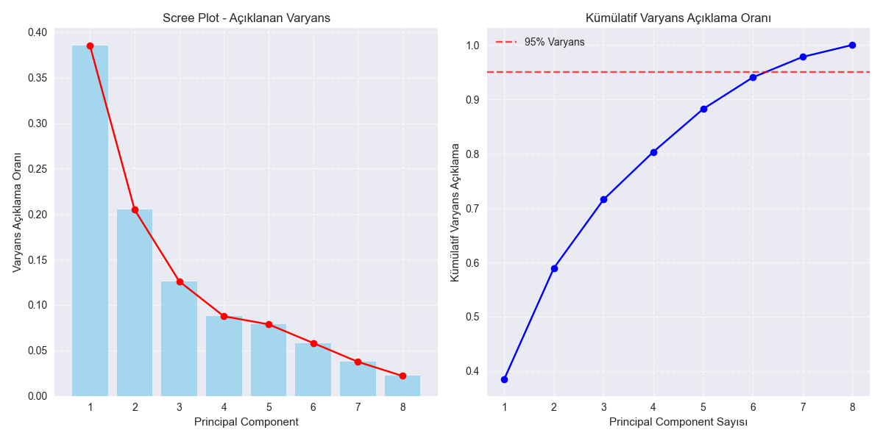
Principal Component Analysis (PCA)
Components | Individual | Cumulative
PC1 | 38.5% | 38.5%
PC2 | 20.5% | 59.0%
PC1-PC6 | - | 94.0%
🔍 Component Interpretation
PC1: "Sales Dimension"
High loadings: NA_Sales, EU_Sales, Other_Sales
Represents commercial success
PC2: "Review Dimension"
High loadings: Critic_Count, User_Count
Represents critical reception

Slide 35
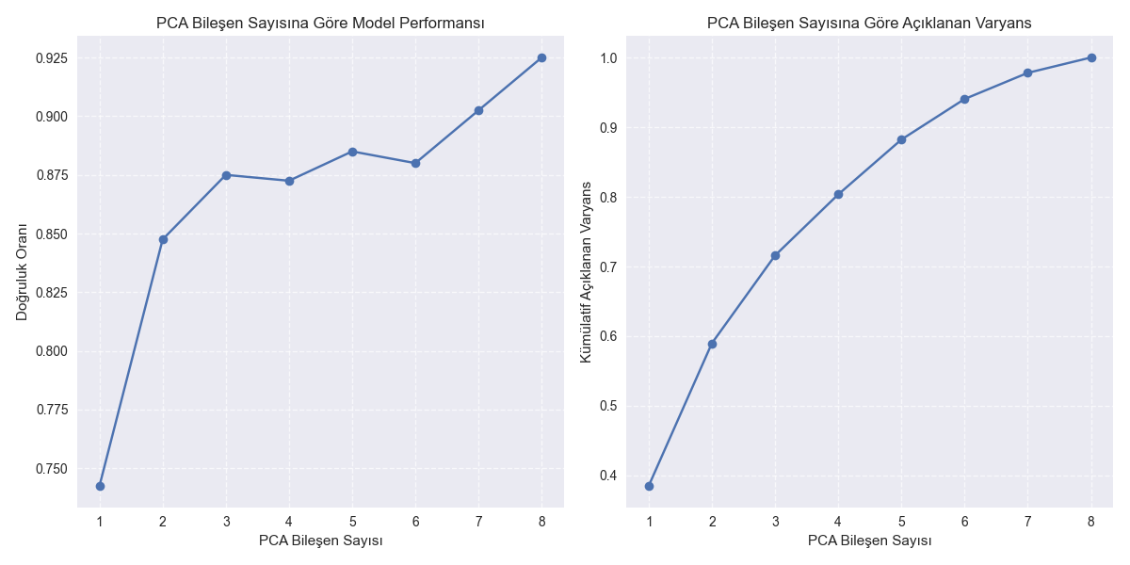
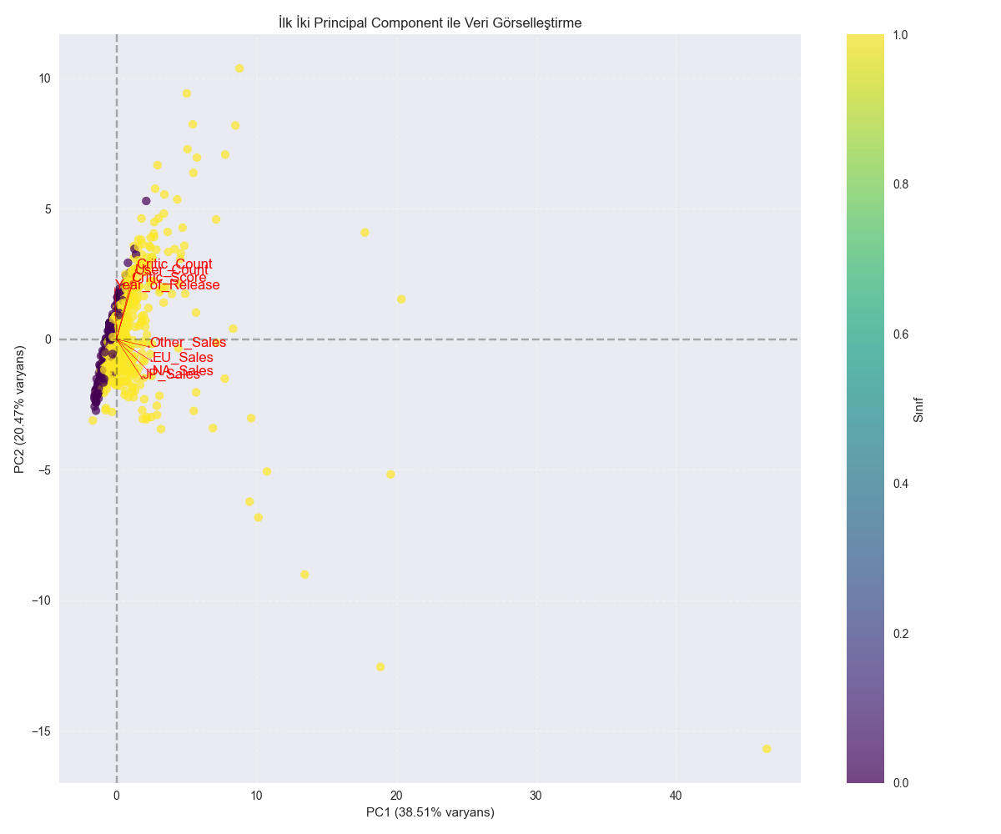
PCA Classification Performance
Components | Accuracy | Variance
4 | 90.0% | 80%
6 | 91.5% | 94%
8 | 92.5% | 100%
🎯 Key Observations
Best PCA performance: 92.5% with all components
Good balance: 91.5% with 6 components (94% variance)
Biplot shows clear separation along PC1 (sales dimension)
Diminishing returns after 6 components

Slide 36
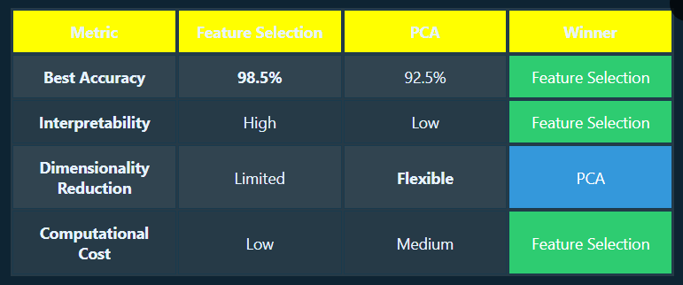
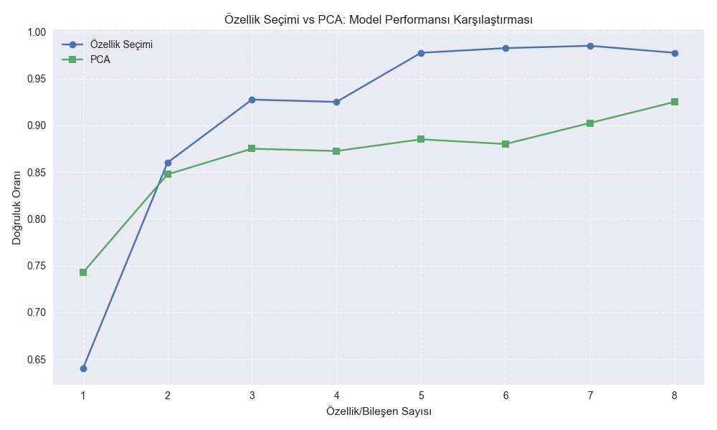
Feature Selection vs PCA

Slide 37
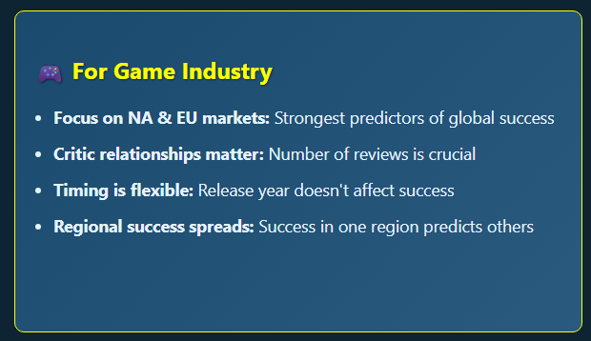
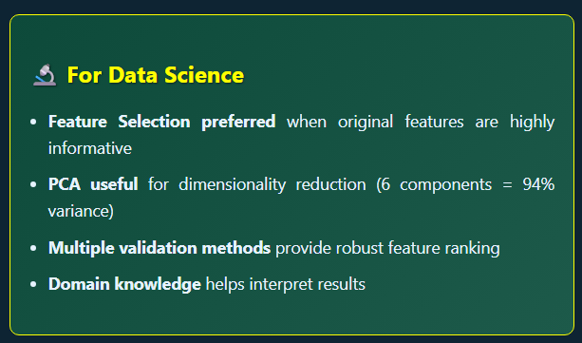
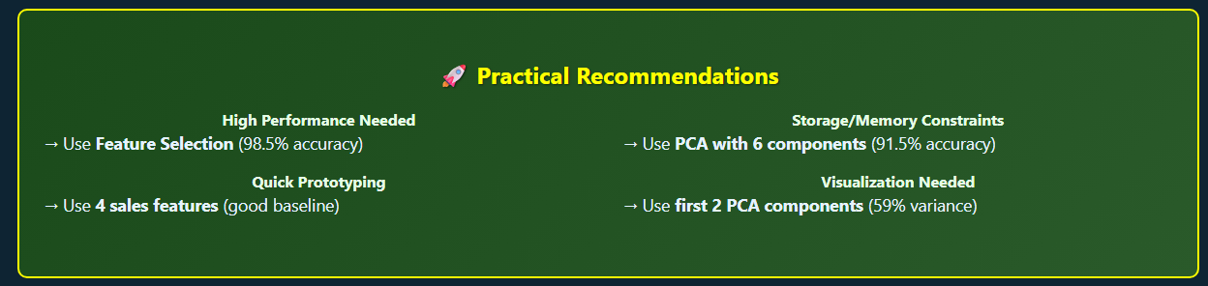
Business Insights & Applications

Slide 38
Final Part

Slide 39
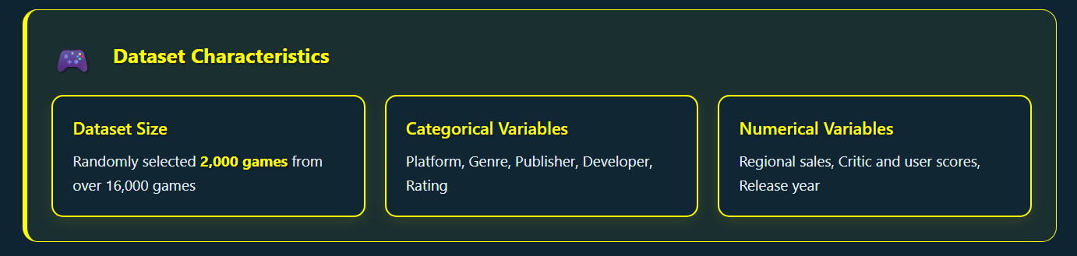
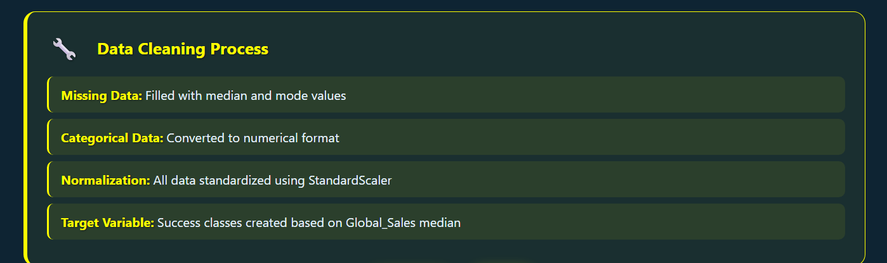
Dataset and Preprocessing

Slide 40

Feature Selection and Dimensionality Reduction
Method Used:
ANOVA F-test
Mutual Information
Random Forest
RFE
Most Effective Features:
NA_Sales - North America sales
EU_Sales - Europe sales
Critic_Count - Number of critics

Slide 41


Clustering Analysis

Slide 42


Classification and Regression Models

Slide 43

Results and Strategic Recommendations
Main Findings:
1. 2. 3.
NA_Sales - Strongest Success Indicator Platform and Genre Selection Critical Critic Scores Influential

Slide 44
Thank you for listening..
Project Files:
explore_video_games.py
analyze_video_games.py
hierarchical_clustering.py
sampled_video_games.csv
Visualizations: PNG format in /plots folder
Classification: PNG format in /plots folder
Regression: PNG format in /plots folder
Source:
https://www.geeksforgeeks.org/working-with-missing-data-in-pandas/
https://www.analyticsvidhya.com/blog/2021/05/dealing-with-missing-values-in-python-a-complete-guide/
https://www.datacamp.com/tutorial/techniques-to-handle-missing-data-values
https://www.kaggle.com/datasets/rush4ratio/video-game-sales-with-ratings
https://scikit-learn.org/stable/
https://www.theesa.com/resource/2024-essential-facts-about-the-video-game-industry/

